Slide 1
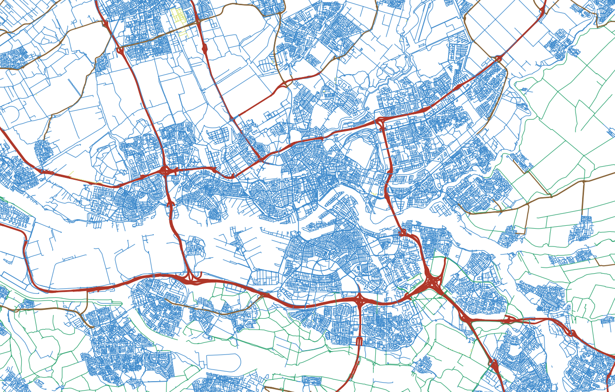

Constructing a digital 3D road network for The Netherlands
MSc Thesis Defence
Kristof Kenesei K.Kenesei@student.tudelft.nl
Supervisors: 1st – Ravi Peters 2nd – Jantien Stoter 2021-06-22
Notes:
Welcome to my thesis defence. The title of my graduation project is “Constructing a digital 3D road network for The Netherlands”.

Slide 2
Agenda
Constructing a digital 3D road network for The Netherlands
Motivation and background
Processing pipeline
Final results and accuracy
Comparison with commercial results
Conclusions
Notes:
Agenda of the presentation will be:
Motivation and some background
Details of the pipeline design and showcase of intermediate results
Final results and accuracy assessment
Outcome of comparison with the commercial results
Concluding remarks

Slide 3


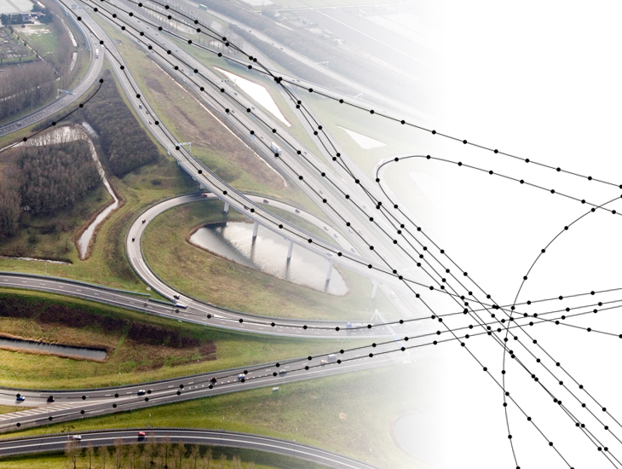
What is NWB?
Motivation and background
Stands for Nationaal Wegenbestand
Produced and maintained by Rijkswaterstaat via NDW (Nationaal Dataportaal Wegverkeer)
Commercial “client” of this project
Open data geospatial product of The Netherlands
Graph-like representation of all named roads in the country
https://nationaalwegenbestand.nl/wat-het-nwb
Notes:
Full name is Nationaal Wegenbestand, which stands for national road product
Open data geospatial product of The Netherlands
Produced and maintained by NDW
They are the commercial “client” of this project
Graph-like representation of all named roads in The Netherlands
Knooppunten: real-life intersections, i.e. graph nodes
Wegwakken: road centreline segments, i.e. graph edges

Slide 4
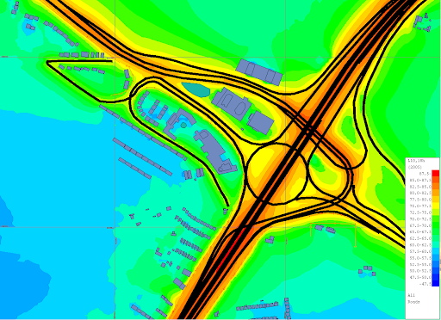
Purpose of georeferencing
Motivation and background
In general:
We can relate the road to its physical surroundings – required in many applications
In this specific case:
This project is relevant to noise modelling
→ Need to know the geographical source of noise
http://www.noisemap.ltd.uk/wpress/features/roads/
Notes:
Georeferencing allows us to relate roads to their surroundings
I.e. to correlate with external information, such as addresses in route planning
Our scenario: NWB is a traffic noise source in a noise propagation model
Position relative to surrounding objects needs to be known
Otherwise the noise load on the objects cannot be determined

Slide 5
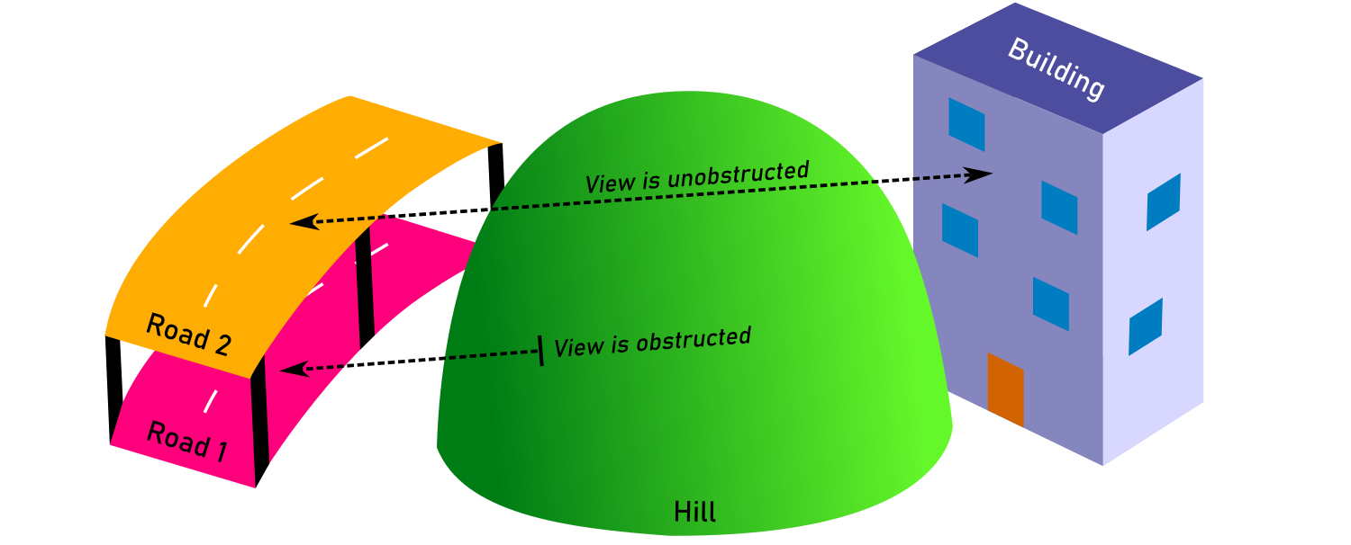
Justifying 3D georeferencing
Motivation and background
Notes:
Traffic noise modelling traditionally done in 2D, but these are not very realistic
A 3D noise propagation model should use a 3D road network
Consider the example:
This is a best case scenario, we already have a terrain model and 3D buildings
If we model the road to always lie on the terrain, then the hill (part of the terrain) will block the noise
If we consider that it is in fact an elevated road, some of the noise will propagate to the building
New noise legislations in The Netherlands prescribe a 3D model

Slide 6
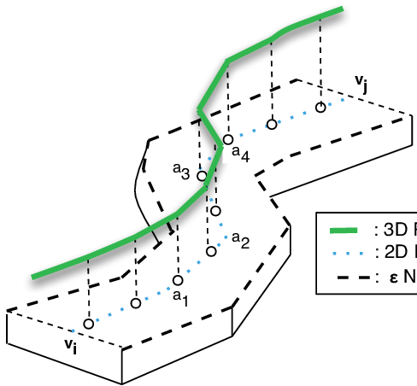
Essence of problem
Motivation and background
https://www.researchgate.net/figure/A-2D-Road-Segment-With-its-Neighborhood-Definition-2-A-3D-spatial-network-is-also_fig2_236964742
How do we get from here…
…to here?
Notes:
So how do we get from a 2D road network (graph) to a 3D road network?
In other words, how do we enrich NWB with elevation data?

Slide 7
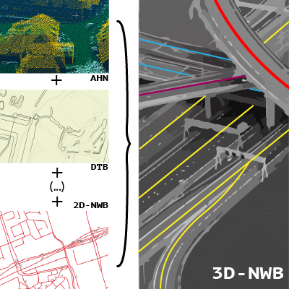
Constraints
Motivation and background
Comply with accuracy requirements
Use existing open-data elevation measurements
Explore academic aspects, not just fulfil a commission
Preserve topology, keep original 2D georeferencing
Try to improve upon the methods of the commercial implementation
Notes:
In addition to the base problem, there are a few constraints
Noise regulations prescribe a 20 cm minimum accuracy at 2 STDs
We wish to use open data datasets only
Explore academic aspects, not only complete a commercial commission
Preserve topology, keep the 2D georeferencing
Compare with, and try to improve upon, the commercial implementation
Was developed in parallel with academic project

Slide 8
Research question
Motivation and background
“How can we achieve a 3D conversion of the NWB dataset using Dutch open geospatial data and primarily 2.5D-based surface modelling methods, while guaranteeing optimal and quantifiable accuracy and completeness?”
Notes:
In the end we came up with the research question:
“How can we achieve a 3D conversion of the NWB dataset using Dutch open geospatial data and primarily 2.5D-based surface modelling methods, while guaranteeing optimal and quantifiable accuracy and completeness?”
2.5D-based surface modelling and scientific accuracy assessment are mentioned specifically because these are the main added academic aspects

Slide 9
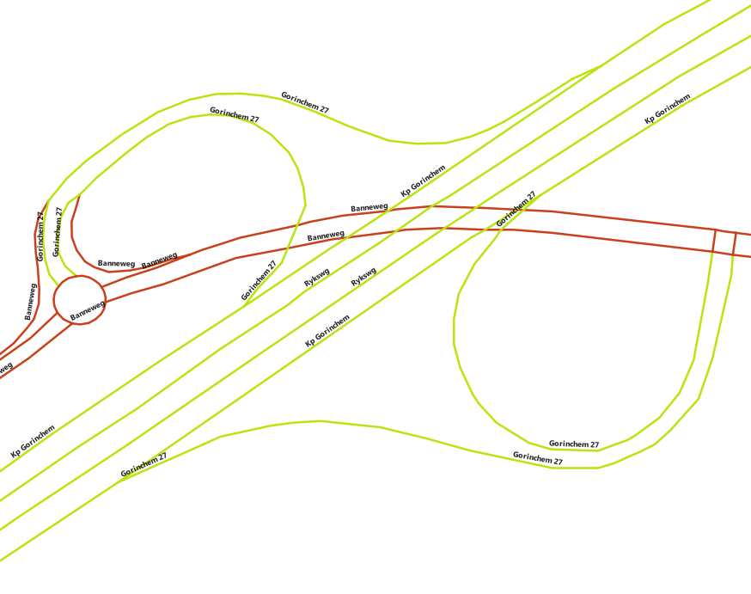
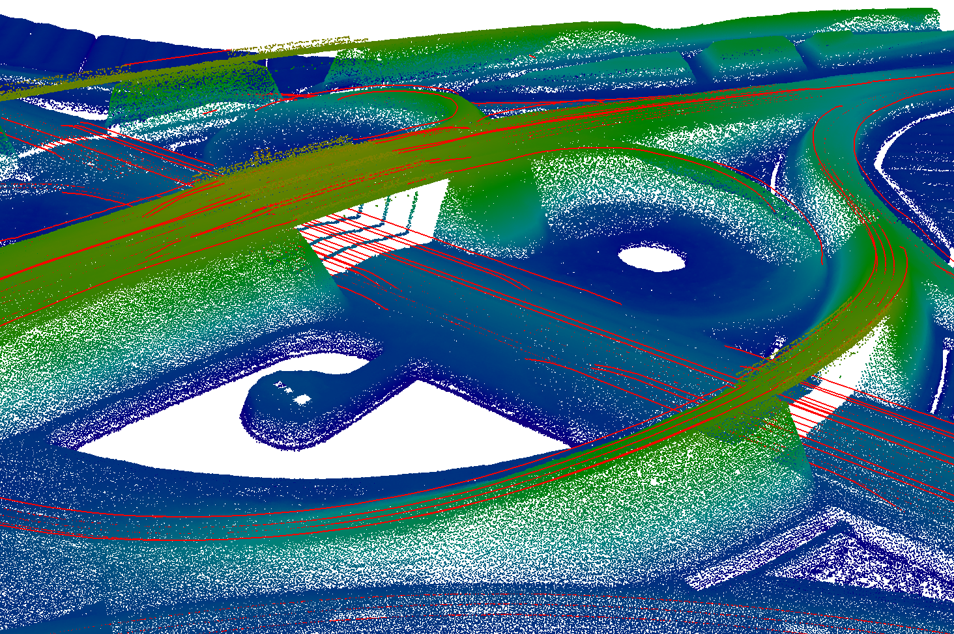
The datasets
Processing pipeline
“… using Dutch open geospatial data …”
2D
3D
NWB motorways (green), provincial roads (brown)
AHN3 points (blue to green points), DTB line features (red lines)
Notes:
The datasets are:
NWB – needs to be converted to 3D
We are only interested in motorways and provincial roads
AHN3 – the Dutch national remote sensing dataset
Cannot penetrate objects that are opaque to light
Difficult to sense 3D relationships due to this
Feature extraction is necessary, which is never perfectly accurate
DTB – a road management dataset of The Netherlands
We use the road marking line models from this dataset
This can provide coverage in AHN3 gaps
Coverage is limited, and it only exists for motorways
Highlighted the relevant part of the main research question

Slide 10
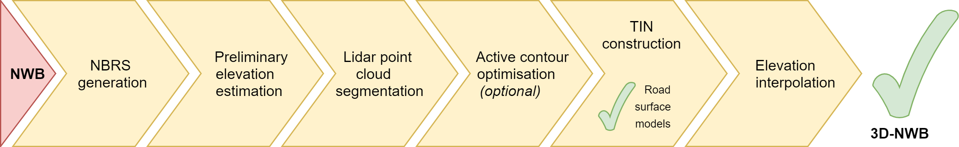
Overview of pipeline steps
Processing pipeline
Mosaicked together from methods found in literature, and own ideas
Made surface modelling a core stage of NWB’s 3D conversion
“… primarily 2.5D-based surface modelling methods …”
Notes:
This flowchart shows our planned processing pipeline
Result of a preparation process that spanned about two months
Performed the necessary literature review
Consulted with NDW and their commercial developer
Mosaicked together the procedure based on the above, and my own ideas
Made the generation of road surface TIN models a core stage
Producing surface models is for research purposes only
Highlighted the relevant part of the main research question

Slide 11
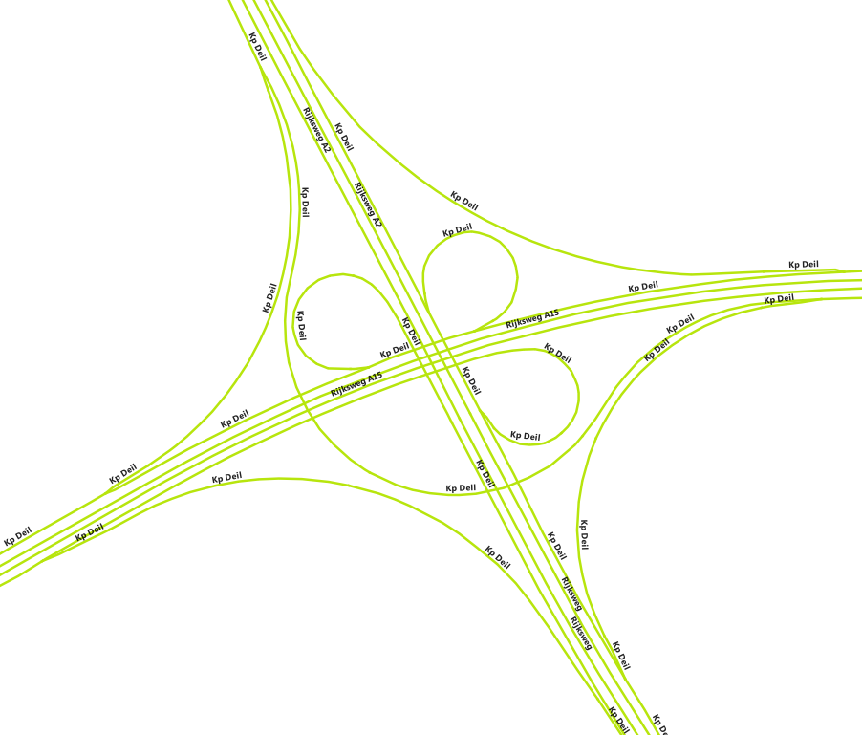
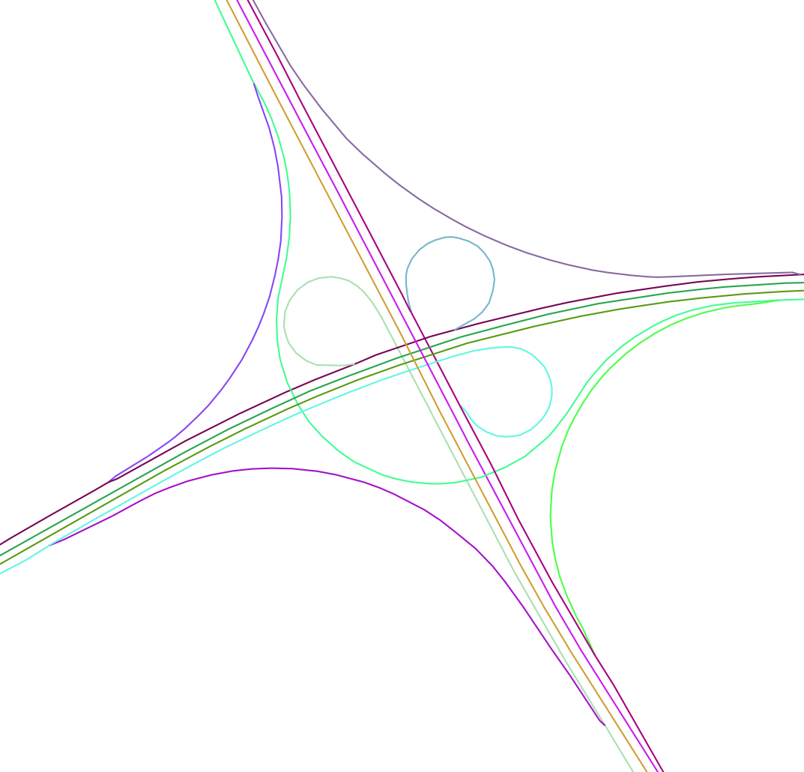
NBRS generation
Processing pipeline
Lidar segmentation
TIN construction
Elevation interpolation
NBRS generation
Edge estimation
Input NWB geometry
Generated NBRS geometries (each colour represents an NBRS)
Issue: various workflow steps would work best with subdivisions of NWB
Solution: “split” NWB into Non-Branching Road Segments (NBRS)
Maximise length, minimise internal angles, disallow self-intersection
Notes:
First step of the pipeline: NBRS generation
Subdivide NWB into well-behaved segments, a prerequisite for various subsequent steps
I call these Non-Branching Road Segments or NBRSs for short
How exactly do we generate NBRSs?
NBRS are assembled from connected wegvakken (the building blocks of NWB)
The algorithms try to maximise length and minimise internal angles
Self-intersections are not allowed – 2.5D modelling is made possible
Implemented two algorithms
“Geometric” algorithm relies only on NWB geometry
“Semantic” algorithm uses attribute data too, but is thus specialised to NWB

Slide 12
Lidar segmentation
Processing pipeline
Lidar segmentation
TIN construction
Elevation interpolation
NBRS generation
Edge estimation
Issue: handling entire point cloud at once is both inefficient and ineffective
Solution: segment point cloud into subclouds with points relevant to each NBRS
Idea during implementation: quickly estimate rough elevations prior to this step (Hypothesis: it will improve segmentation effectiveness)
Notes:
What is Lidar segmentation?
In our case, it means the selection and grouping of Lidar points…
…that are relevant to the underlying road surface of each NBRS
Why do we need Lidar segmentation?
In short: to improve performance and make subsequent steps more effective
Starting from a 2D road network limits effectiveness → try to first create a rough 3D conversion of NWB

Slide 13
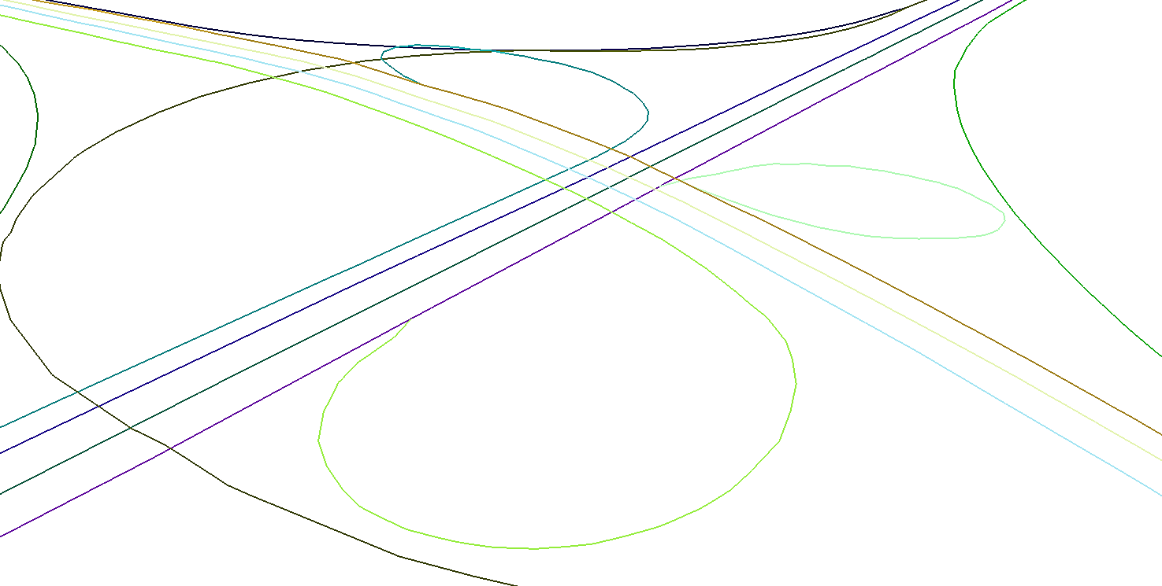
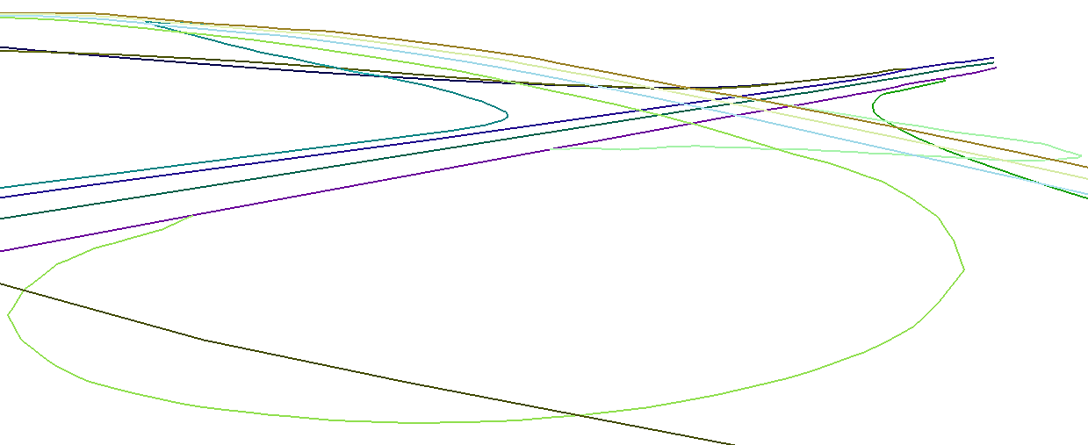
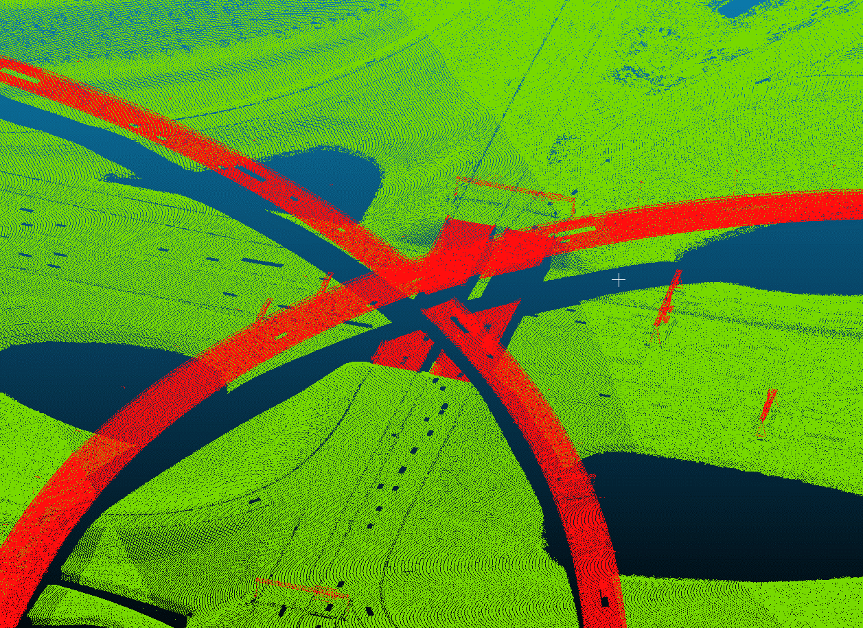
Elevation estimation
Processing pipeline
NBRS generation
Lidar segmentation
TIN construction
Elevation estimation
Edge estimation
Elevation interpolation
2D NBRS geometries
3D-converted NBRS geometries
Top view
Side view
AHN3 point cloud
+
Issue: Lidar segmentation may be more efficient using approximate road elevations
Solution: perform a rough, very quick 3D conversion of NWB
Notes:
Added a step to the pipeline: elevation estimation
The goal is to extract elevations for NWB from AHN3
As quickly as possible
And keeping the algorithm relatively simple
Really just to provide a starting point for later steps

Slide 14
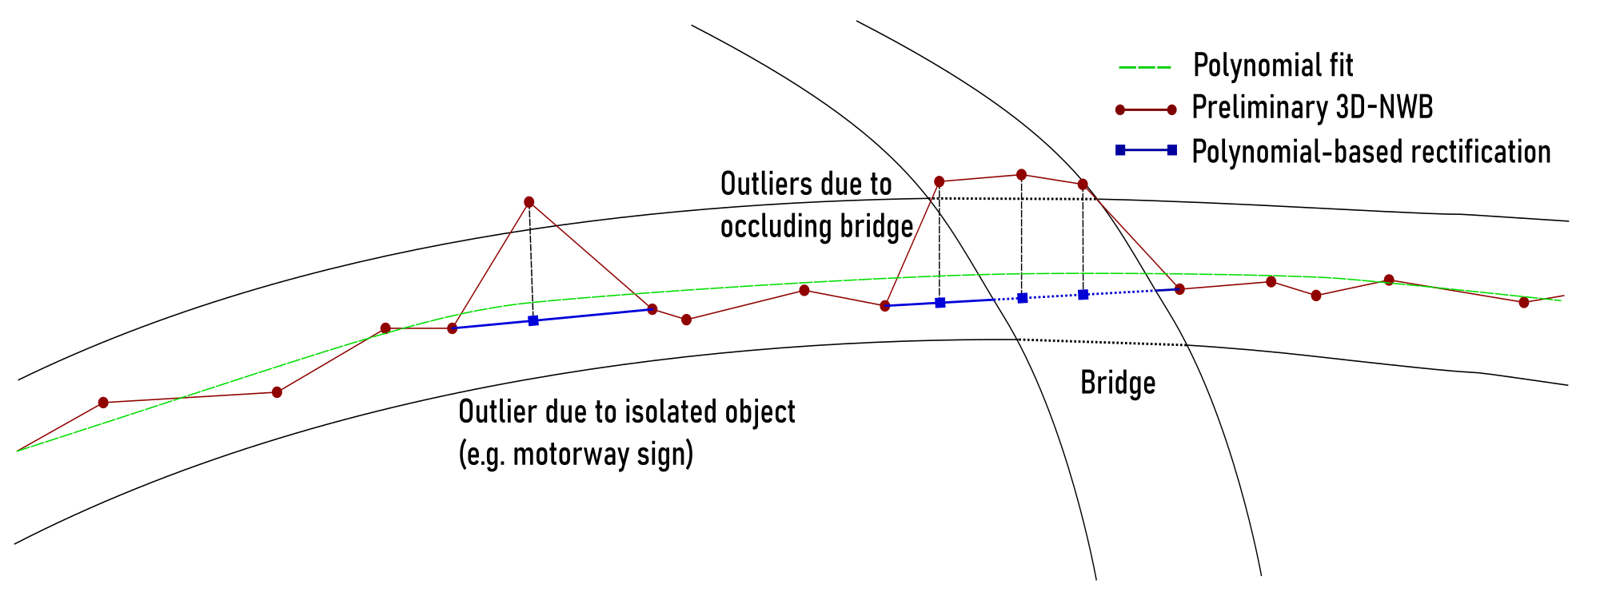
Elevation estimation
Processing pipeline
NBRS generation
Lidar segmentation
TIN construction
Elevation estimation
Edge estimation
Elevation interpolation
Notes:
The implemented workflow is simple:
Densify vertices where necessary
It means the addition of vertices where line segments are very long
Allows us to better sample the elevation data
At each NWB vertex, query AHN3 for nearby points and derive an elevation value
Red vertices/lines in figure
Fit polynomials on the 2D profiles represented by each NBRS to identify outliers
Illustrated by green line
Interpolate new values for the outliers via linear interpolation
Blue vertices and lines
The results are surprisingly accurate wherever the elevation profiles of the roads are relatively simple

Slide 15
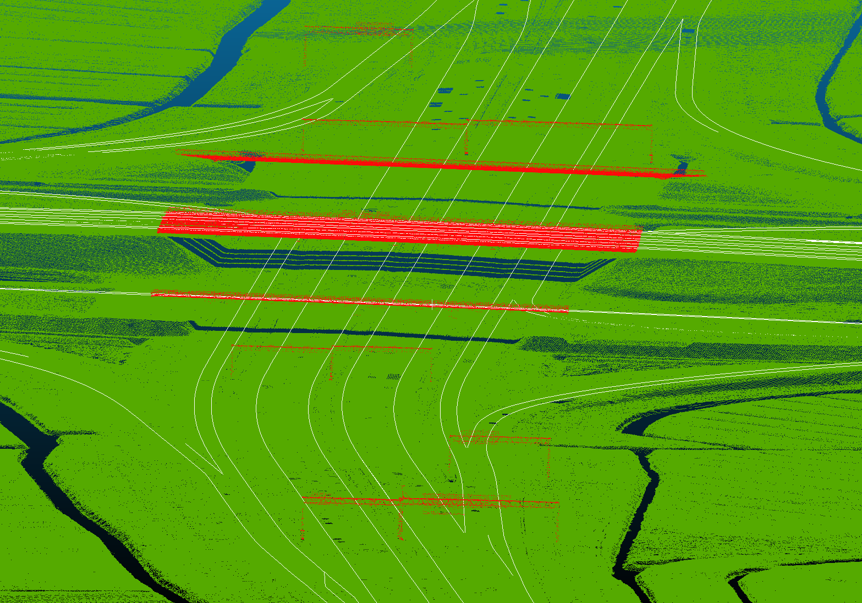
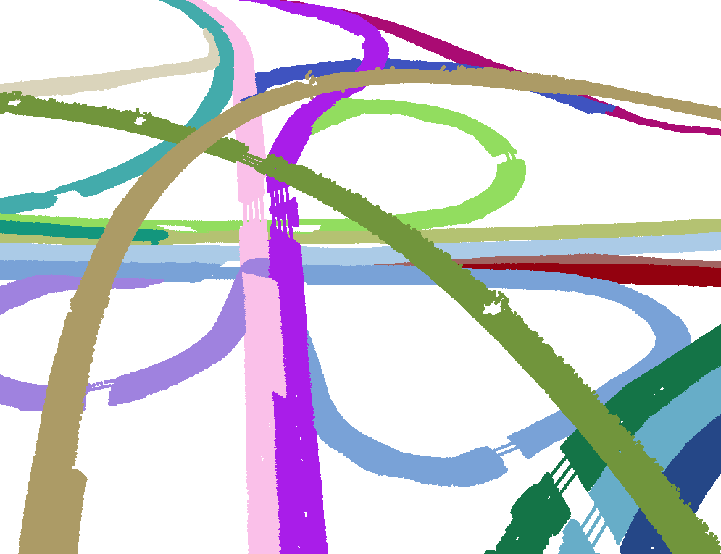
Lidar segmentation
Processing pipeline
NBRS generation
Lidar segmentation
TIN construction
Elevation estimation
Edge estimation
Elevation interpolation
AHN3 point cloud, DTB lines
Subclouds
+
3D NBRS geometries
Issue: handling entire point cloud at once is both inefficient and ineffective
Solution: segment point cloud into subclouds with points relevant to each NBRS
Notes:
Next step in pipeline: Lidar segmentation
The preliminary elevations proved to indeed be useful
Thanks to them, less irrelevant Lidar points are examined in complex areas
DTB is used in conjunction with AHN3
It is used both as an elevation source, and as reference (like the 3D centrelines)

Slide 16
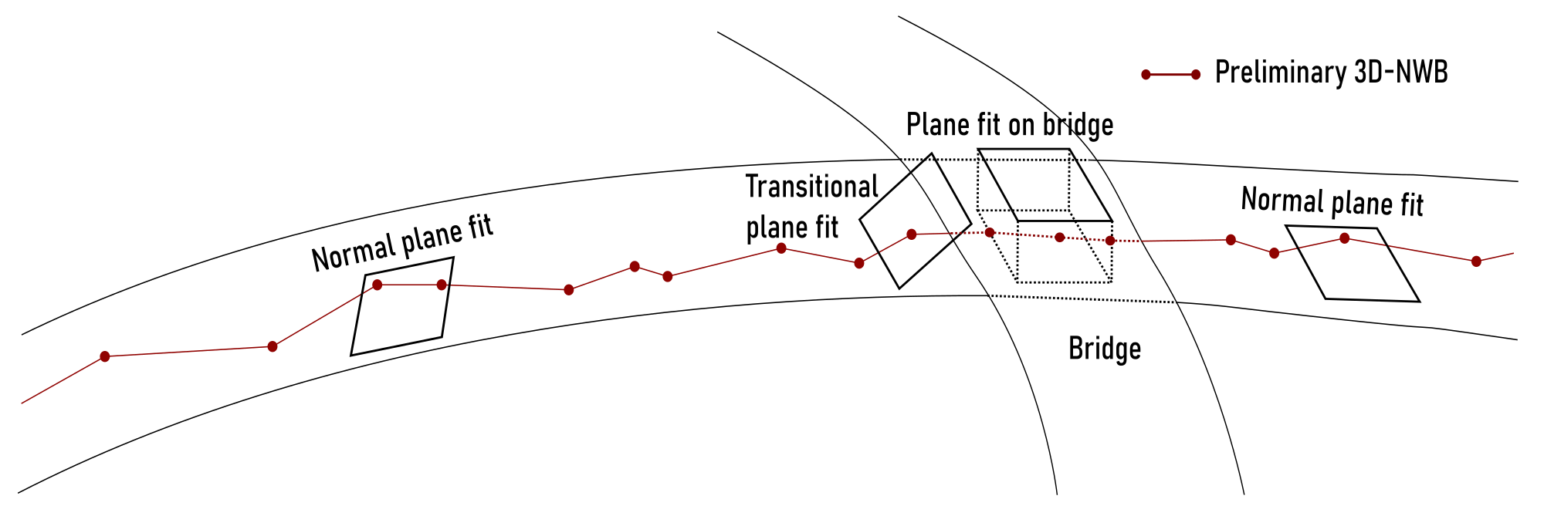
Lidar segmentation
Processing pipeline
NBRS generation
Lidar segmentation
TIN construction
Elevation estimation
Edge estimation
Elevation interpolation
Notes:
Workflow:
Fit planes on point cloud points close to each NBRS vertex
3D squares and red vertices/lines in illustration, respectively
For each vertex, pre-select close-by points that conform with local plane fit
Not shown here
Progressing along NBRS vertices, detect shifts in the planes
Such as the transitional plane illustrated here
If DTB can be used to disambiguate, make use of it
Such as underneath the bridge here
Also use its (densified) vertices where reliable
Accept planes (and conformant points) which agree with the global trend of the NBRS
→ Assemble the subclouds
Detecting transitional plane fits was key, and also the most challenging task

Slide 17
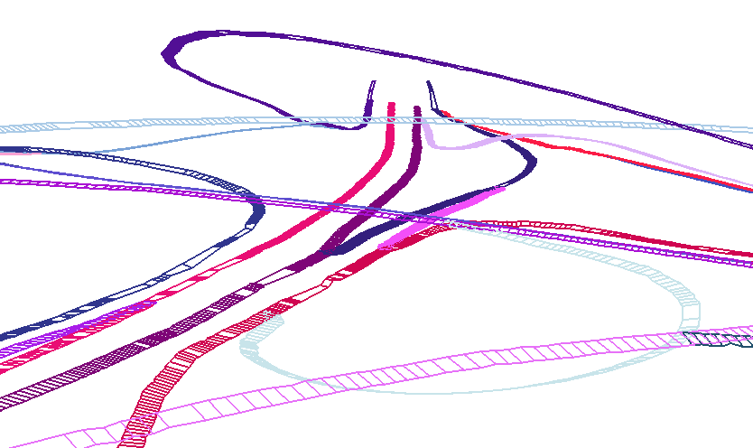
Edge estimation
Processing pipeline
NBRS generation
Lidar segmentation
TIN construction
Elevation estimation
Edge estimation
Elevation interpolation
Subclouds
+
2D NBRS geometries
Issue: we need seed contours for active contour optimisation
Solution: generate seed contours (= edge estimates) by inspecting cross-section trends
Notes:
Next step in pipeline: edge approximation
We are looking for 3D lines that approximately delineate the smooth, traffic-occupied parts of roads.
These were originally going to be optimised in the next pipeline step
Key part of original plan to accurately classify road surface reflections

Slide 18
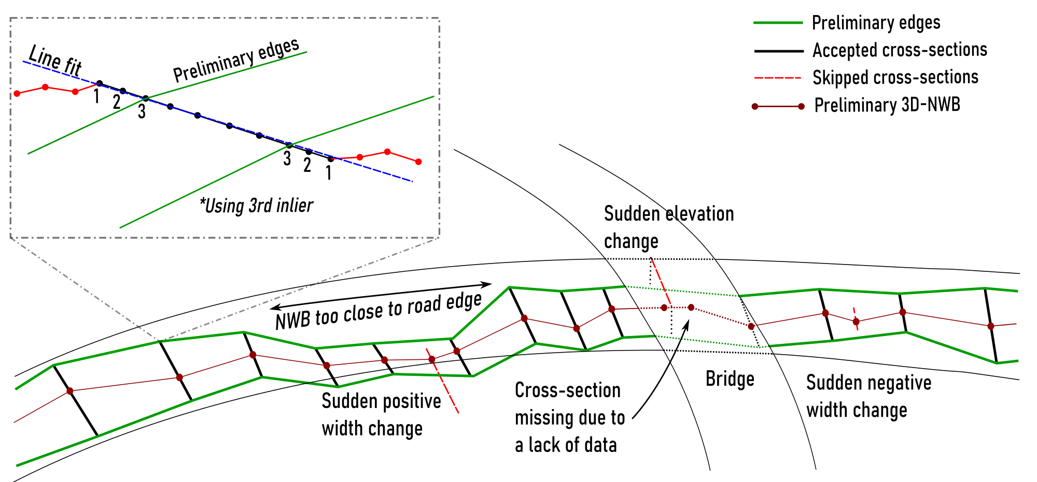
Edge estimation
Processing pipeline
NBRS generation
Lidar segmentation
TIN construction
Elevation estimation
Edge estimation
Elevation interpolation
Notes:
Workflow:
Construct cross-sections on NBRS vertices and densify them
Black vertices and lines in inset
Compute elevations for them from nearby part of relevant subcloud
Not shown here
Select suitable edge points on both sides of NBRS from inliers based on line fit
Dashed blue line
Discard non-conformant cross-sections
Dashed red lines
Assemble preliminary edges of NBRS from these discrete edge points
Green lines
Dealing with NWB getting close to road edges was the most challenging aspect
Shown in illustration
This is due to NWB’s coarse/inaccurate 2D georeferencing

Slide 19
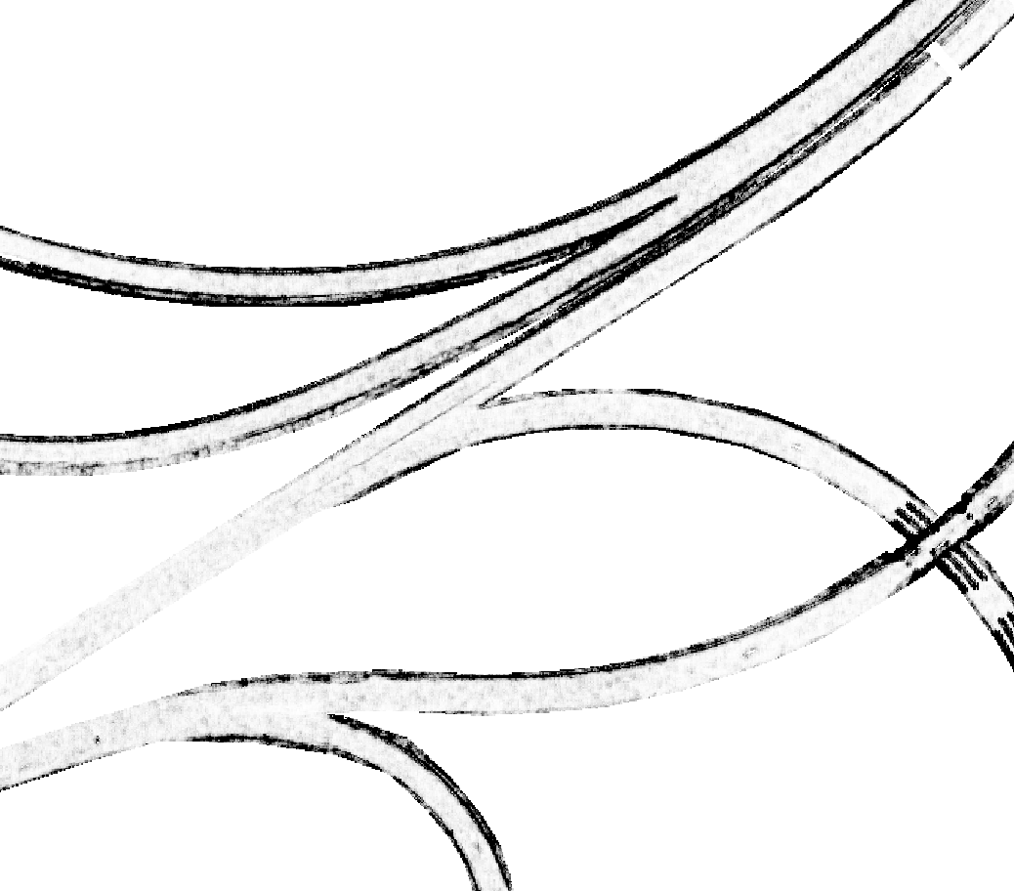

Edge optimisation
Processing pipeline
Edge optimisation
NBRS generation
Lidar segmentation
TIN construction
Elevation estimation
Edge estimation
Elevation interpolation
Subclouds
Attractor maps
Optimised edges
+
Preliminary edges
Issue: preliminary edges are angular, often do not cover the whole road surface
Solution: iteratively improve edges using active contour optimisation (snakes)
Notes:
Next step in pipeline: edge optimisation
This was a core part of the original pipeline design
The original intention was to generate rough preliminary edges…
…then optimise them using active contour optimisation…
…to thus be able to select road surface reflections with near-perfect accuracy
Workflow:
Construct attractor maps for each NBRS
They are rasters that describe how smooth the Lidar-defined surface is locally
Run active contour optimisation for each NBRS, inputting the attractor maps and preliminary edges

Slide 20
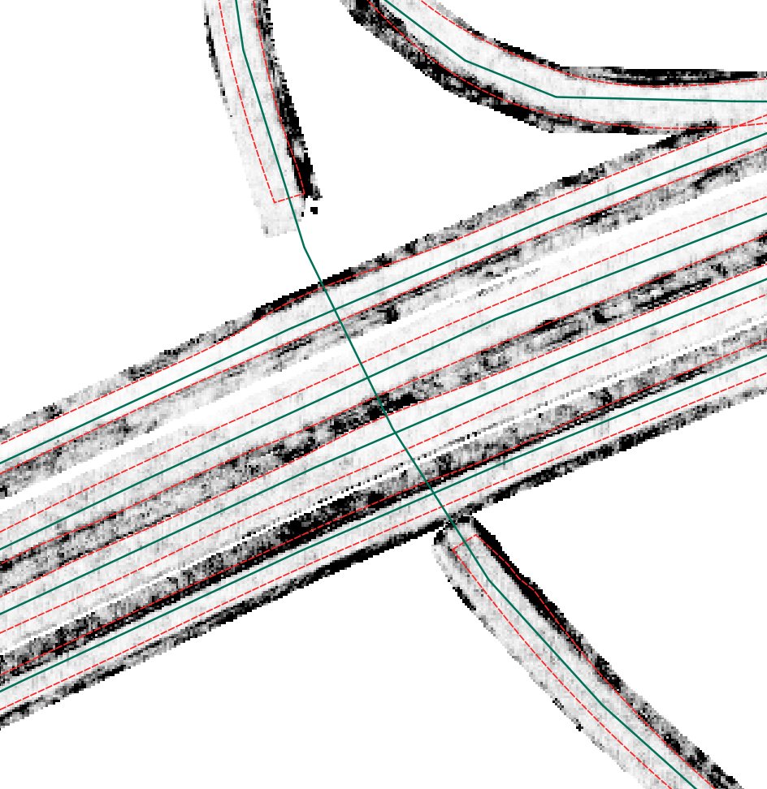
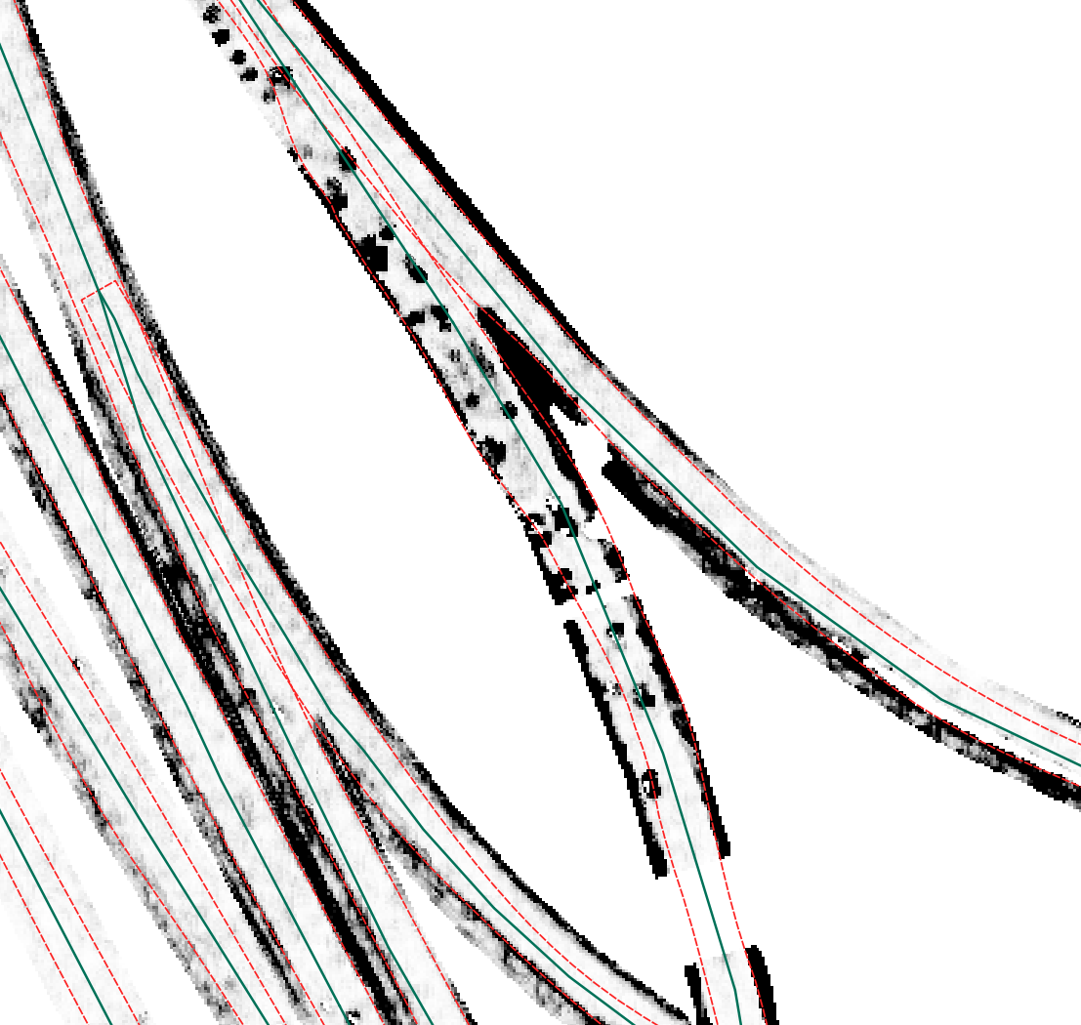
Edge optimisation
Processing pipeline
Edge optimisation
NBRS generation
Lidar segmentation
TIN construction
Elevation estimation
Edge estimation
Elevation interpolation
Edge not in raster / too far
Ideal edges
Perturbation due to vehicles
Contour not on road
Issues during implementation: active contour optimisation does not perform well enough. → Made it optional in the final pipeline configuration.
Notes:
This did not pan out as well as I was hoping
Using conventional active contour optimisation, some edges are drawn too far inwards or outwards
Imperfect attractor maps result in disruptive artefacts
Difficult to find a parametrisation that works in all possible scenarios
I only found implementations of basic active contour optimisation, not advanced ones
I eventually decided to phase out edge optimisation (made it optional, it can still be used)
Research timeframe did not allow me to spend more time on this
Required significant modifications to the edge estimation and TIN construction steps

Slide 21
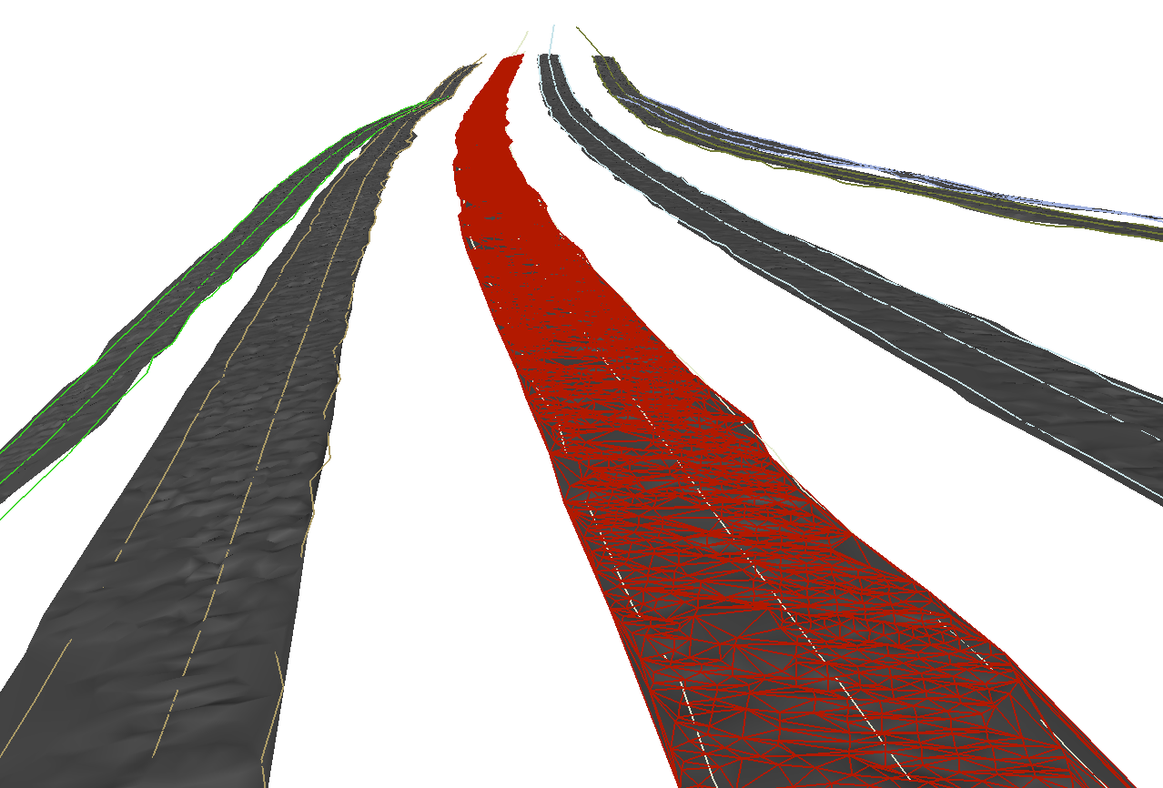
TIN construction
Processing pipeline
NBRS generation
Lidar segmentation
TIN construction
Elevation estimation
Edge estimation
Elevation interpolation
Subclouds
TIN road surface models
Preliminary edges
OR
Optimised edges
Issue: need to create an efficient interpolation structure to obtain final elevations
Also: academic desire to model road surfaces
Solution: build TIN models from subcloud points incrementally
Notes:
Next step in pipeline: TIN construction
Need to create an interpolation structure from where elevations for NWB can be extracted effectively
Also want to model road surfaces – why not do both in a single step?
Original intention was to just construct a CDT using the optimised edges and the Lidar points between them
After phasing out edge optimisation, it was necessary to do this differently
The TINs are now constructed incrementally, via a surface growing process

Slide 22
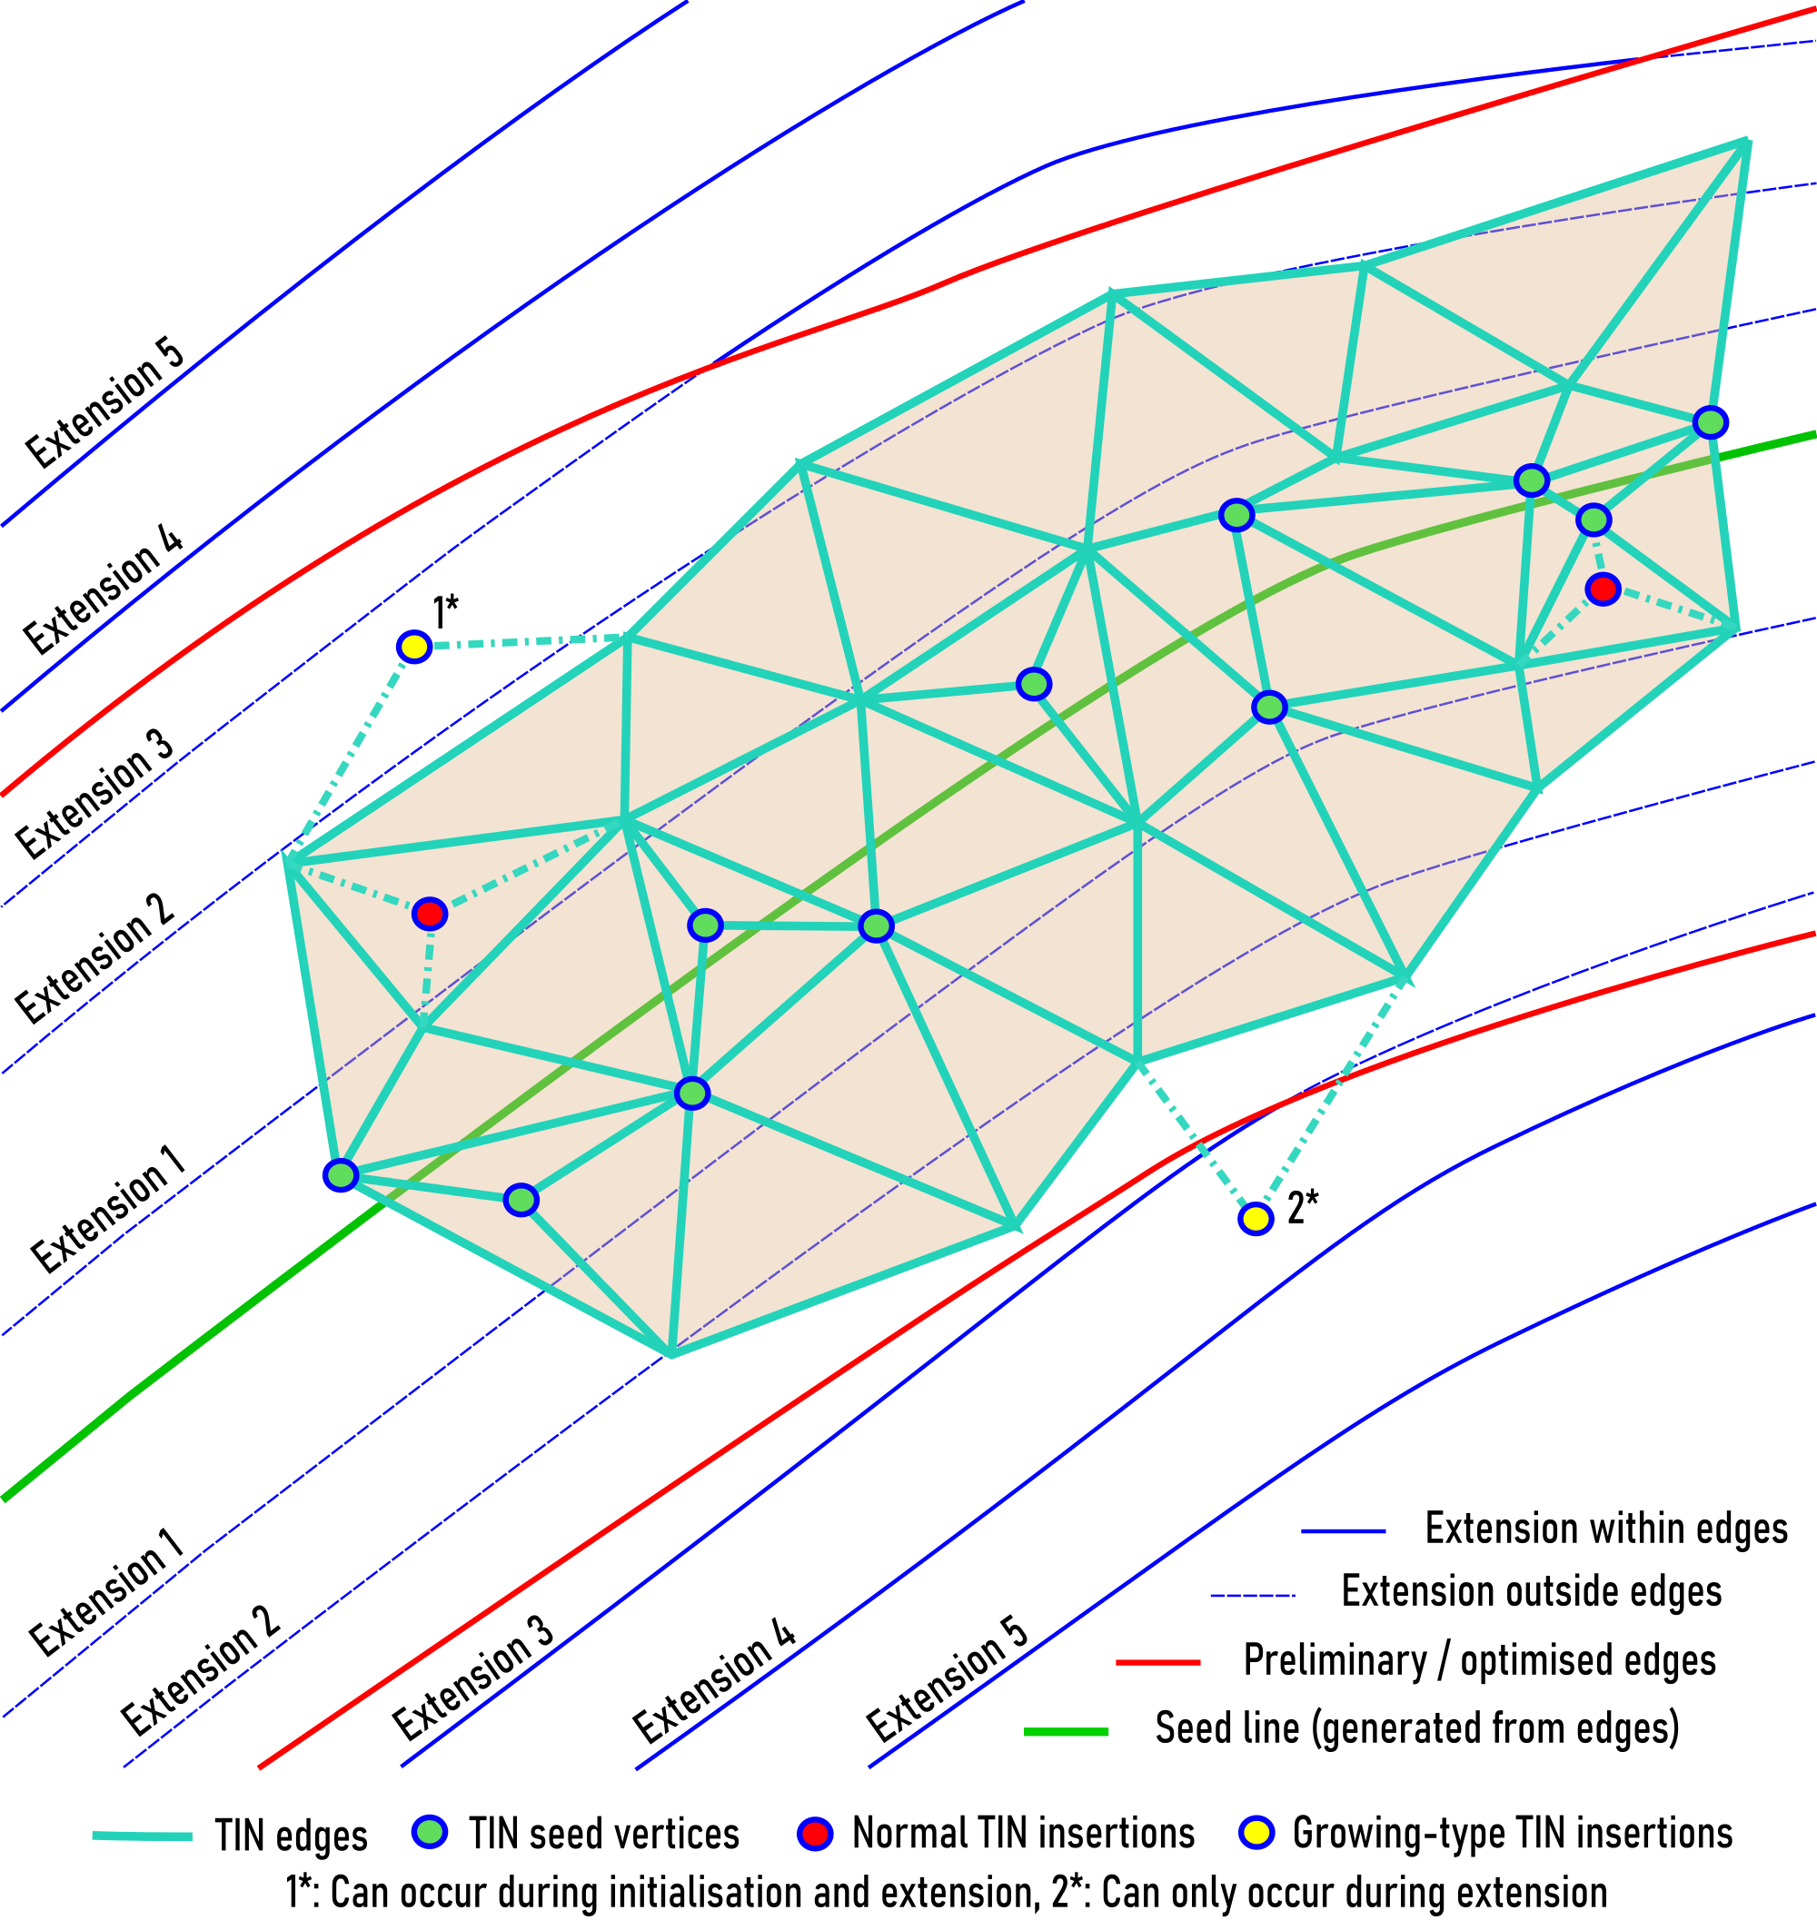
TIN construction
Processing pipeline
NBRS generation
Lidar segmentation
TIN construction
Elevation estimation
Edge estimation
Elevation interpolation
Notes:
Workflow:
Seed the TIN using points close to the skeleton of road edges
Green line and green points, edges shown as red lines
Grow the TIN within the edges using an algorithm inspired by TIN-based ground filtering workflows
Normal conditional insertions are shown as red points, insertions take place if point conforms with local triangle
Growing-type insertions are shown as yellow points, these inspect the local planar trend in a larger area
Extend the TIN beyond the edges using targeted conditional insertions between extension boundaries (optional)
For instance, in extension 3, Lidar points between the blue lines labelled “Extension 3” and “Extension 4” would be considered
Can help fill areas missed by the previous step, such as hard shoulders

Slide 23
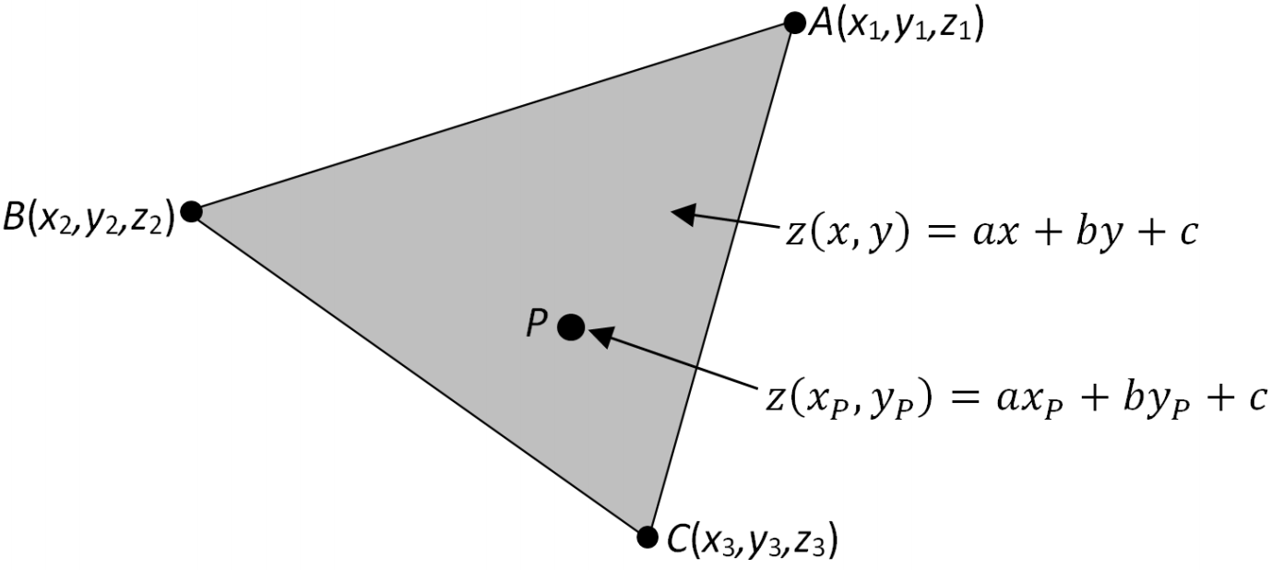
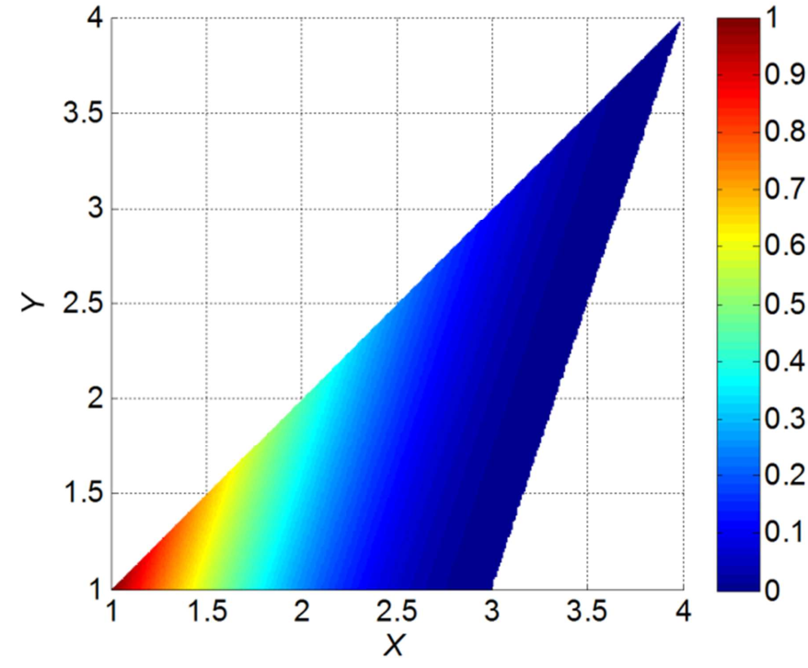
Elevation interpolation
Processing pipeline
NBRS generation
Lidar segmentation
TIN construction
Elevation estimation
Edge estimation
Elevation interpolation
Issue: need to convert NWB to 3D based on the surface models
Solution:
Interpolate NWB vertices in the TINs of each NBRS
Where TIN does not exist, use linear interpolation as a post-processing step
Figures from:
Fan, L., Smethurst, J., P.M., A., and Powrie, W. (2014), Propagation of vertical and horizontal source data errors into a tin with linear interpolation. International, Journal of Geographical Information Science, 28:1378–1400.
TIN-linear interpolation background
Weight of leftmost vertex
Notes:
Next step in pipeline: elevation interpolation
Workflow:
Interpolate NBRS vertex elevations in corresponding TINs
Take care to ensure continuity in intersections across NBRS
Interpolate missing values linearly where the TINs do not exist locally
As a post-processing step
Using the TIN-linear interpolator
The points are projected onto the triangle’s surface, in which they are found
The weight of each triangle vertex decreases away from it, as shown in the figure
The output file is identical to the input in every aspect other than the added Z coordinates

Slide 24
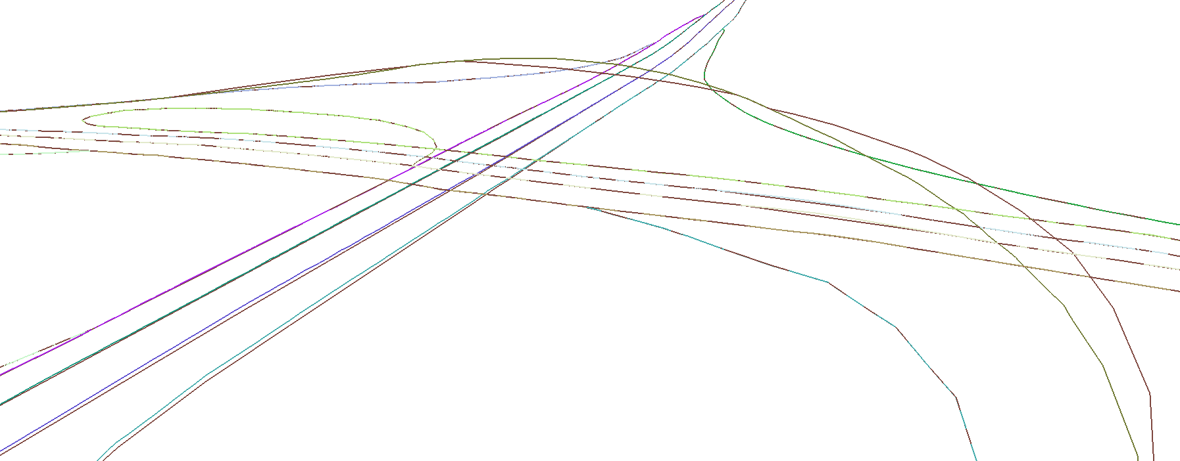
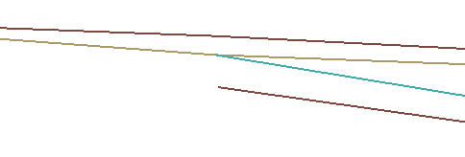
Comparison with preliminary elevations
Final results and accuracy
Final (colour-coded) and preliminary (brown) 3D-NWB geometry
Continuity enforcement
Notes:
The final elevations represent an improvement relative to the preliminary 3D geometries
The final 3D centrelines are more realistic where curvature is complex
Continuity is now being enforced
Less smooth, because each elevation is based on exactly three Lidar points, rather than a patch

Slide 25
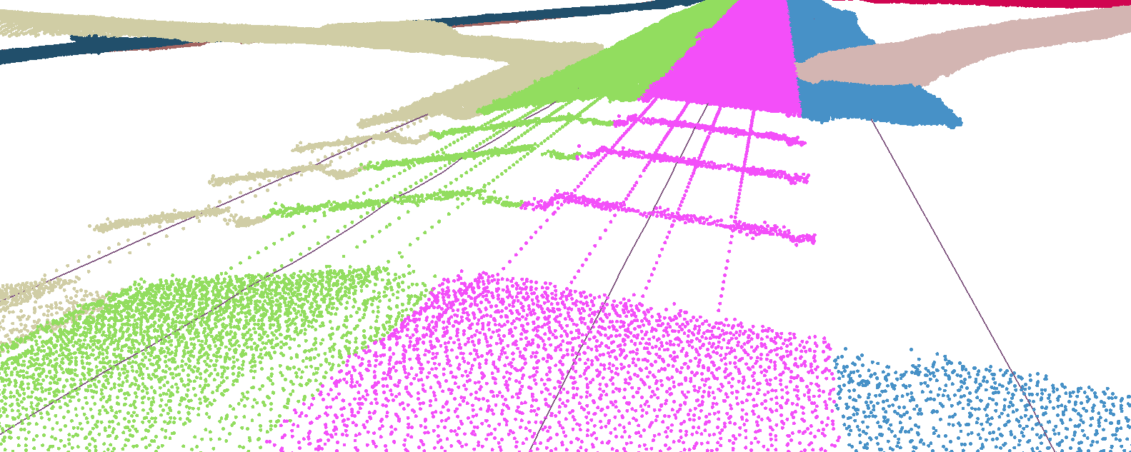
Comparison with subclouds
Final results and accuracy
Linear interpolation
“Hanging bridges” due to switching between AHN3 and DTB
DTB-based TIN-linear interpolation
AHN3-based TIN-linear interpolation
Subclouds and final 3D-NWB geometry
Notes:
Comparison of the final 3D-NWB geometries and the subclouds
Switching between AHN3 and DTB can be spotted
Even where very little difference exists between two datasets
Where AHN3 data is available, the final 3D-NWB geometry is fully defined by it
Linear interpolation reasonable where no DTB data is available and the gaps are small

Slide 26

Completeness of TINs
Final results and accuracy
NWB is close to road edge
Final TINs
Edges of paved areas
Final TINs and paved surface extents (BGT)
Notes:
Current pipeline does not allow the paved surfaces to be fully modelled
This was my original goal
Approximately 75% of the paved surfaces are modelled
Here this is slightly lower, as motorways are very wide
For provincial roads it can be above 90%
Traffic-occupied surfaces are fully covered under normal circumstances
This is due to the combined limitations of the edge estimation and TIN construction algorithms
Could be overcome with further work
Is a result of phasing out edge optimisation (original assumption: edges will be near-perfect)

Slide 27
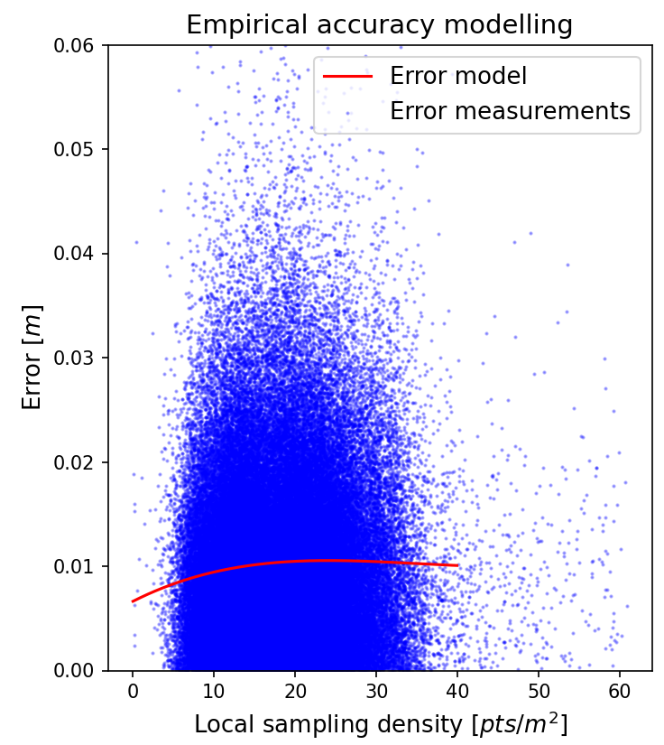
Assumptions regarding accuracy
Final results and accuracy
“… while guaranteeing optimal and quantifiable accuracy and completeness?”
We are building “road surface DTMs” and interpolating in them
Ground point classification assumed to be perfect
Road slope and ruggedness assumed to be negligible
Sampling density assumed to be high enough not to affect accuracy
→ Only the theoretical, propagated error matters
Notes:
Ultimate assumption is: we are effectively constructing DTMs from Lidar data
Lidar data has been ground filtered nearly perfectly
Road slope and ruggedness assumed to be negligible (smooth, relatively flat surfaces)
Sampling density is high enough to describe the surfaces well
This is very much the case in general, as diagram shows
→ Output elevation accuracy can be determined via theoretical error propagation alone
Highlighted the relevant part of the main research question

Slide 28
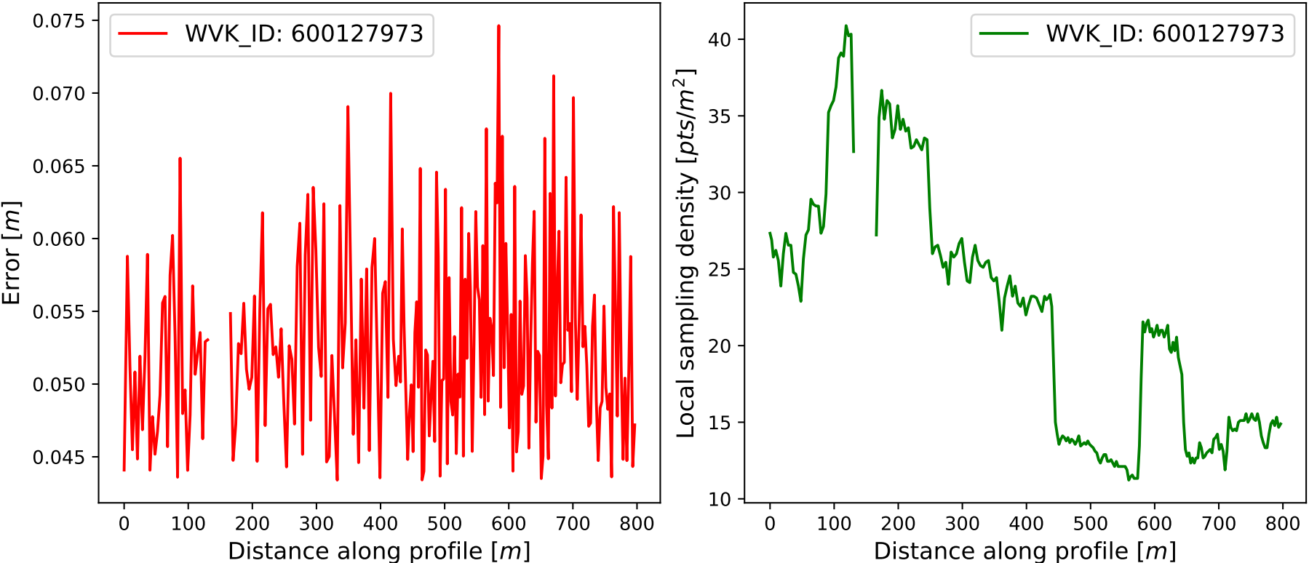
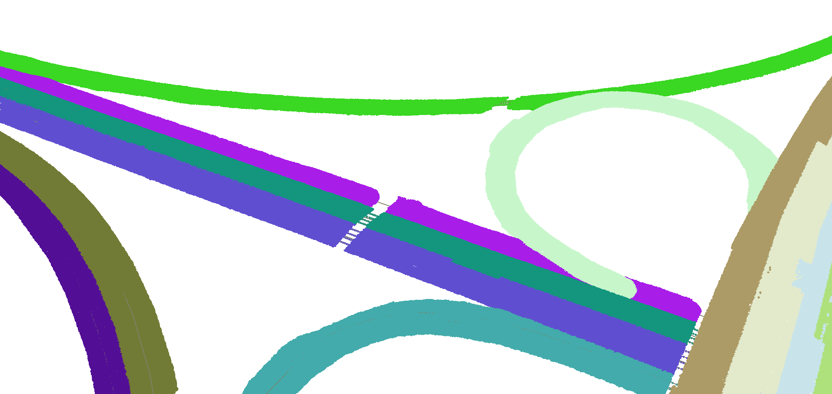
Theoretical accuracy quantification
Final results and accuracy
WVK #600127973
Sampling density drops below minimum
Using a density threshold of 3 points per m²
Local sampling density is measured in the TINs
Generally, violations only occur in data gaps
Output elevation accuracy is around 5.3 cm at 2 STDs
Mean sampling density is 14-27 points per m² in my testing datasets
Notes:
Theoretical error in TIN-linear interpolation roughly constant
Because of the absence of steeply sloping triangles
Output elevation accuracy thus constant, and fully determined by input accuracy
Sampling density in TINs remains high almost everywhere, where there is AHN3 coverage

Slide 29
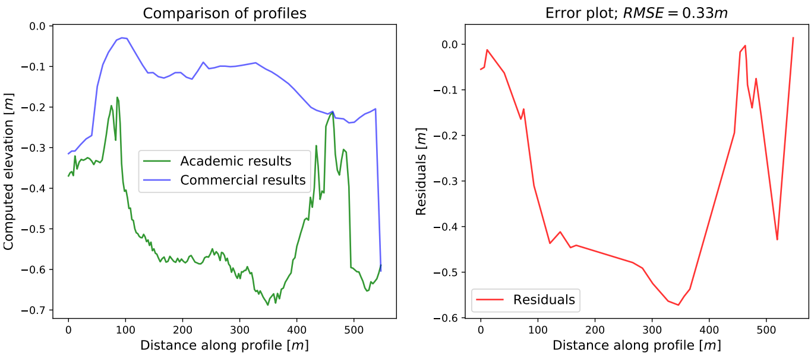
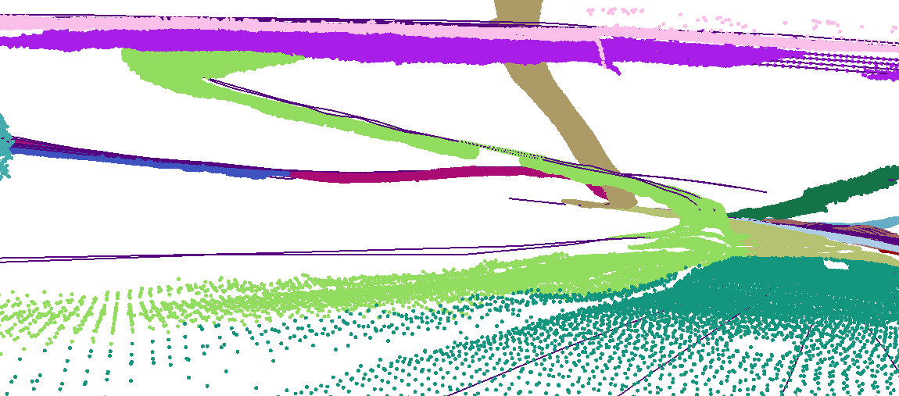
DTB-related differences
Comparison with commercial results
Significant disagreement between AHN3 and DTB
Commercial implementation prioritises DTB unconditionally
However, outdated elevation measurements are common in DTB
In part, can be explained with subsidence
Differences in the range of 0.1 to 1 m are found in my testing datasets
Observable in comparisons wherever commercial program uses DTB
Notes:
Moving on to the comparison with the commercial results
The primary source of disagreement is related to DTB
DTB contains lots of outdated elevation data
The commercial implementation always prioritises DTB in the case of motorways
These differences are carried over directly into the two sets of results
Hypothesis is that this is ultimately due to subsidence
Other factors may also be partly responsible
RMSE values between 1 to 15 cm where agreement is good
RMSE values above 50 cm common where DTB is very outdated
Commercial solution makes better use of DTB, because it is specialised to it

Slide 30
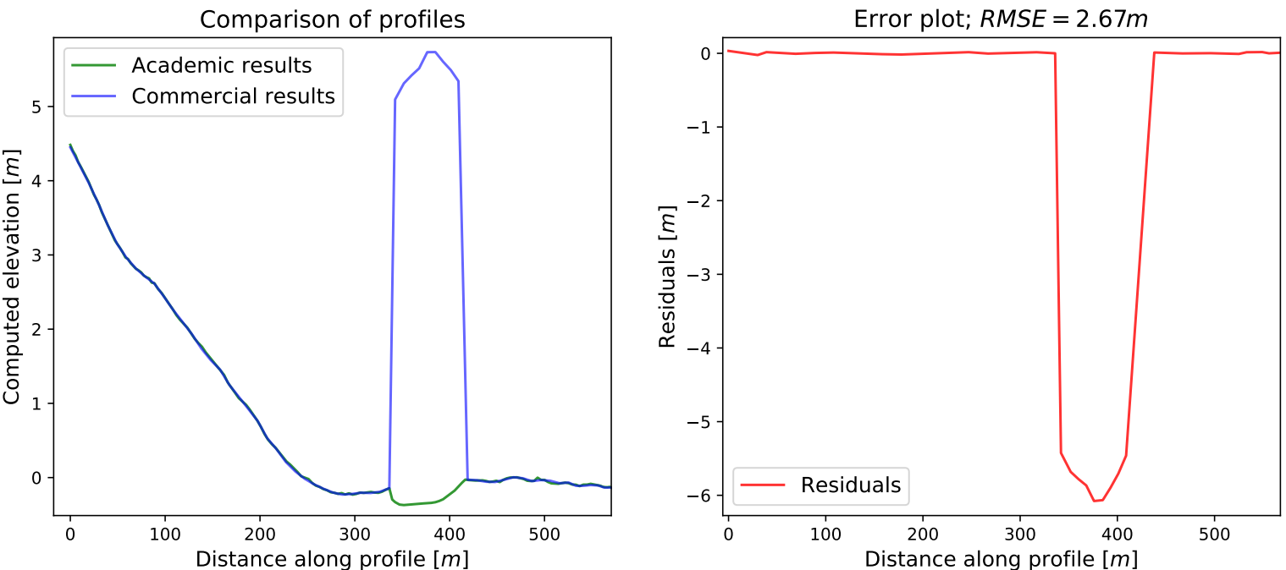
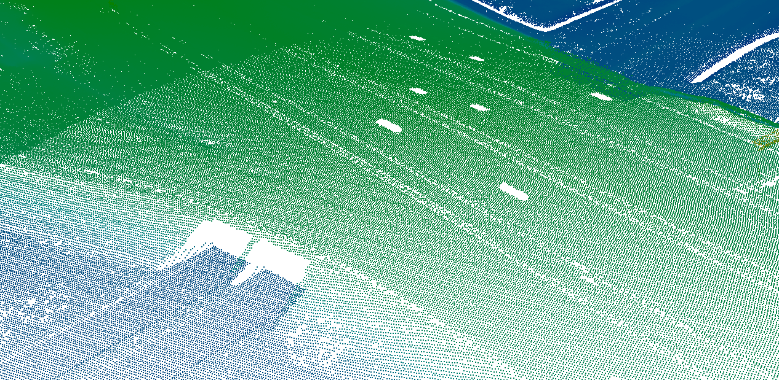
Occlusion-related differences
Comparison with commercial results
“Hanging bridge” due to DTB
Elevation difference between road surfaces
Commercial implementation does not handle occlusion explicitly
It assumes that DTB exists where AHN3 does not
Where this is violated, it produces large positive outliers
Notes:
Commercial implementation has no explicit means of dealing with occlusion
Elevations are grossly overestimated where there is occlusion…
…wherever DTB is missing on motorways
…always in the case of provincial roads
As shown, the profile simply jumps to the elevation of the bridge
This is because here the commercial implementation interpolates in infilled AHN3 DTM gaps
The academic pipeline deals with these issues effectively, even where DTB is absent
Commercial solution works without a scaling solution

Slide 31
Concluding remarks
Conclusions
Pipeline can transpose NWB to 3D via AHN3 and DTB
AHN3 was found to be very useful
DTB should be improved significantly, or replaced by another dataset
NWB’s georeferencing issues caused some headache
Active contour optimisation was found to be unsuitable
The completeness of the generated TINs could be improved
Certain parts of the pipeline could be skipped conditionally
It would suffice to insert far less points into the TINs
For full scale rollout, a scaling solution still needs to be developed
Pipeline is well-documented, source code is available open-source
Notes:
Pipeline can transpose NWB to 3D via AHN3 and DTB
5-10% interpolated linearly, another few percent via DTB
Rest can be regarded accurate, compliant with noise regulations (< 20 cm at 2 STDs)
AHN3 was found to be suitable for this project, but not DTB
DTB’s issues should be resolved, or better still, it could be replaced with an MLS dataset
NWB’s georeferencing issues caused some headache, it should be improved
NDW is already working on it, my thesis contains a comparison
(Basic) active contour optimisation is not suitable to this application
And is not recommended for future work
The completeness of the generated TINs could be improved via additional work
Certain parts of the pipeline could be skipped conditionally, where they are not necessary
I.e. were preliminary elevations are accurate enough
This could improve runtimes considerably
Less points should be inserted into the TINs
Somewhere slightly above the minimum sampling density would suffice
For full scale rollout, a scaling solution still needs to be developed
Pipeline is well-documented, source code of the implementation available open-source

Slide 32
Constructing a digital 3D road network for The Netherlands
Thank you for your attention!
&
Thank you for all your support throughout my graduation year!
Notes:
Thank you for your attention, and I would like to thank my mentors and family for their help and support throughout my graduation year.

Slide 33
Constructing a digital 3D road network for The Netherlands
Questions
Notes:
We can now move on to any questions you may have.

